Slide 1
Urban Waste Management Optimization
Project Presentation
Prepared by [Rohini Hiremath]

Slide 2
🎯 Objective
Analyze waste collection efficiency in a city
Recommend improvements in pickup routes & frequency
Reduce operational cost and fuel consumption
Minimize bin overflow incidents and complaints
Improve recycling efficiency and landfill usage

Slide 3
Methodology Overview
Data Collection
Data Cleaning & Integration
Database Storage
Exploratory Data Analysis (EDA)
Predictive Modeling
Visualization & Dash boarding
Recommendations & Optimization

Slide 4
1: Data Collection & Preparation
Collect disposal logs (bins filled, timestamps, locations)
Include population density & landfill capacity
Integrate data from IoT sensors in smart bins
Normalize GPS & timestamps; remove duplicates & outliers
Clean missing data using or Python

Slide 5
2: Store Data in MySQL Database
Create tables: bins, waste_logs, recycling_stats
Use foreign keys for relational integrity
Index GPS/timestamps for faster queries
Query bins with frequent overflow incidents

Slide 6
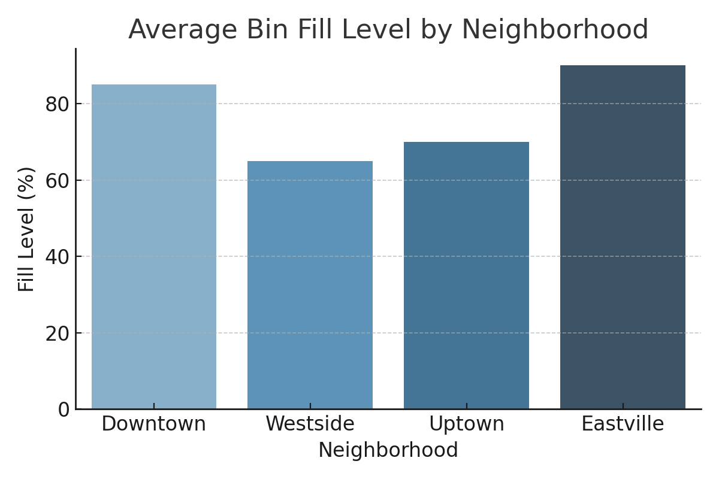
3: Exploratory Data Analysis (EDA)
Analyze collection efficiency by neighborhood
Identify bins that overflow within 24 hours
Compare weekday vs. weekend fill patterns
Correlate population density with fill rates

Slide 7
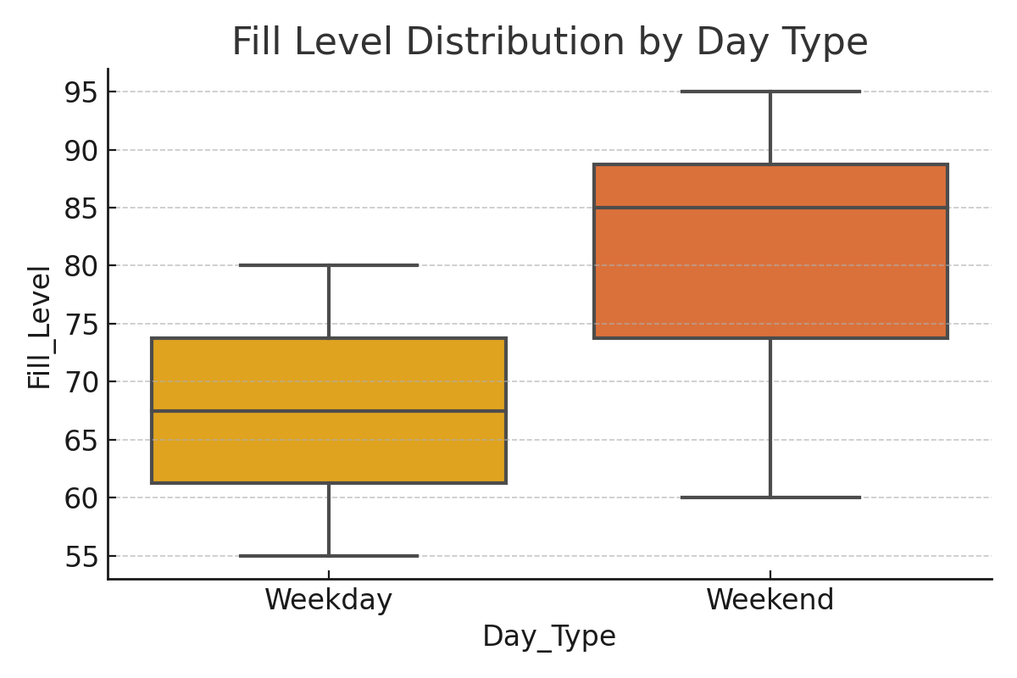
4: Predictive Analysis Using ML
Use Linear Regression to predict waste accumulation
Train/Test split & RMSE for evaluation
Predict days-to-overflow using past data
Explore Ridge Regression or Decision Trees

Slide 8
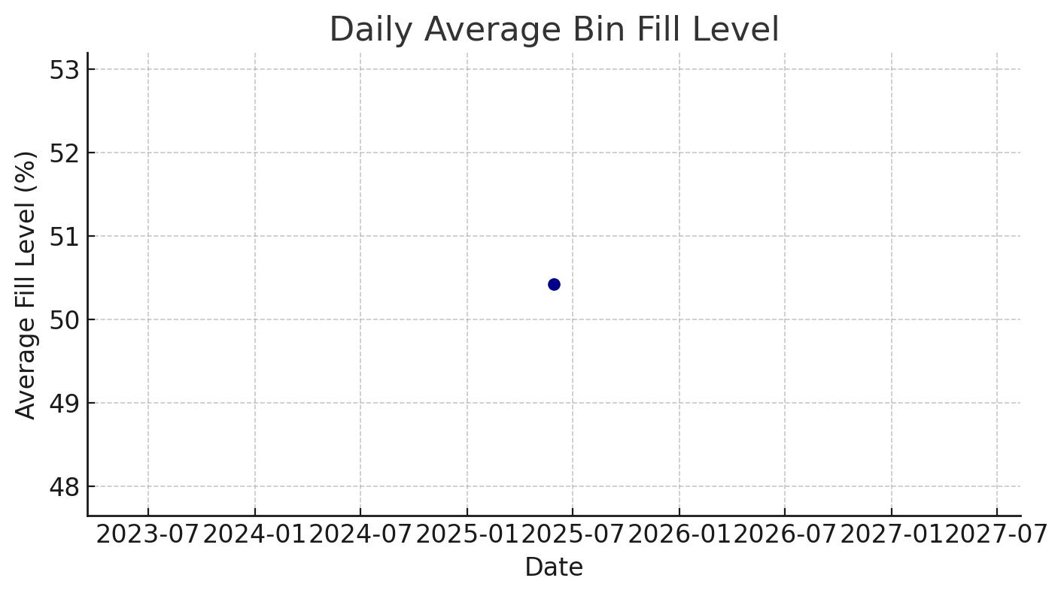
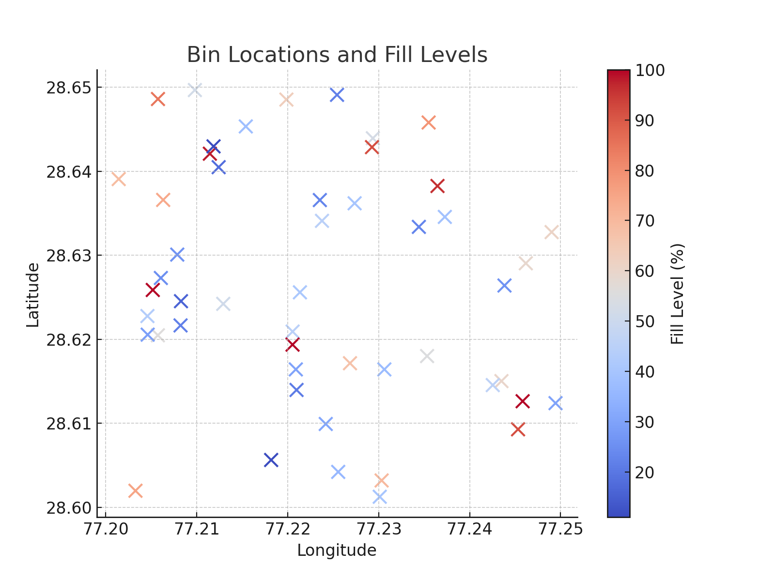
Power BI Dashboard
Daily Average Bin Fill Level
Bin Locations with Fill Levels

Slide 9
6: Report & Recommendations
Increase frequency in commercial zones
Install bins in high-footfall areas
Use predictive alerts to notify teams
Deploy AI-based dynamic routing

Slide 10
Key Benefits
20–30% reduction in route distance
15% increase in recycling bin usage
Faster response to full bins
Lower fuel and labor costs

